Slide 1
Negritude, Pan-Africanism, and Postcolonial African Identity
Okwui Enwezor and Octavio Zaya

Slide 2
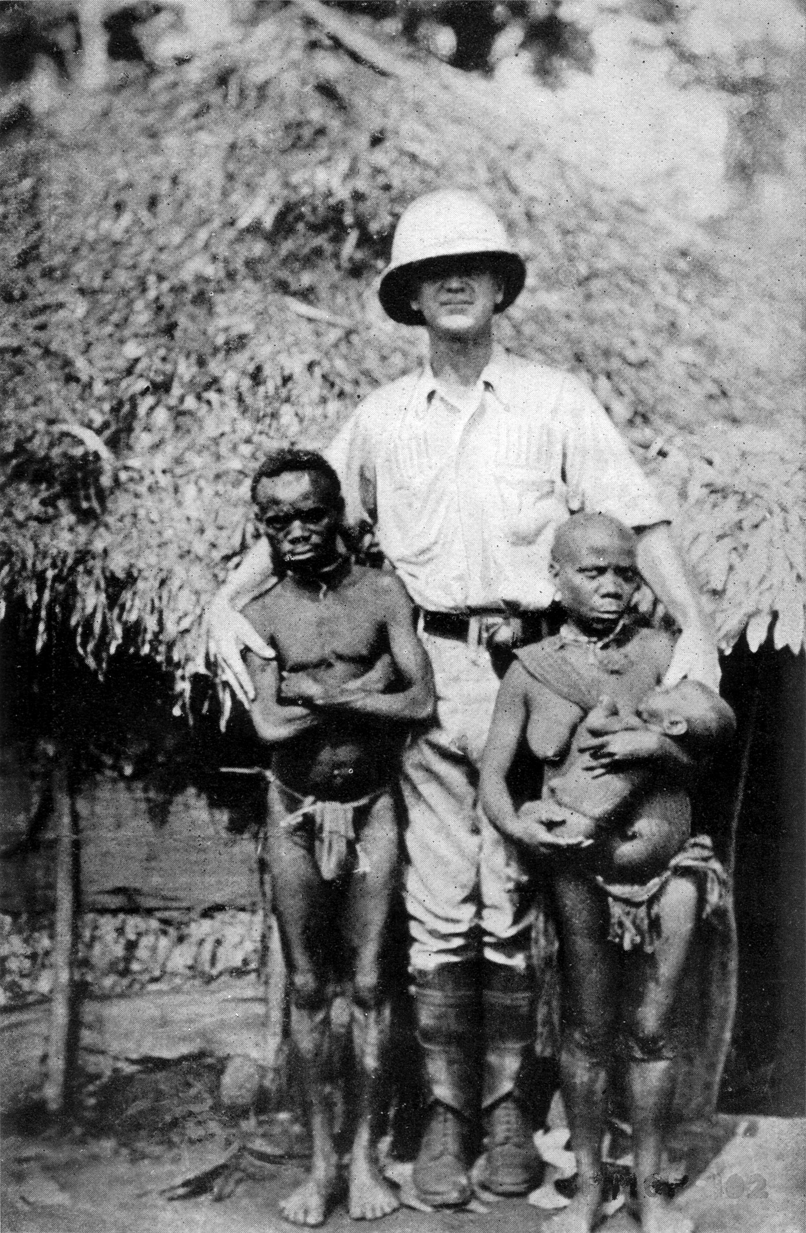
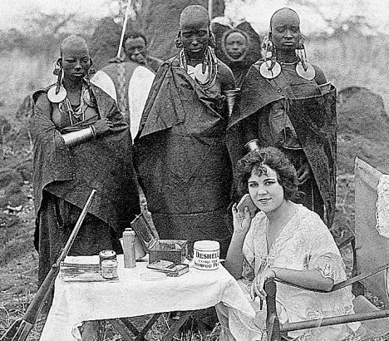
Early 20th century photographs of indigenous Africans through the lens of European colonizers

Slide 3
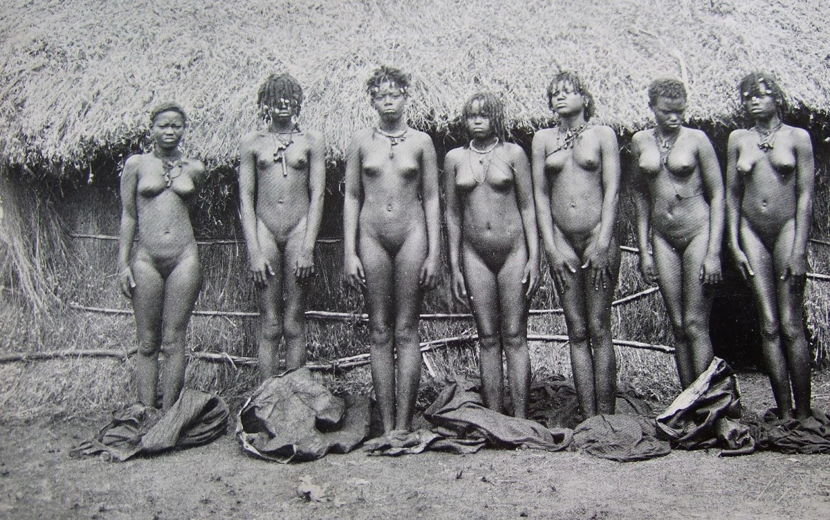
Max Weitz (ethnographer), Physique and Stature, 1908

Slide 4
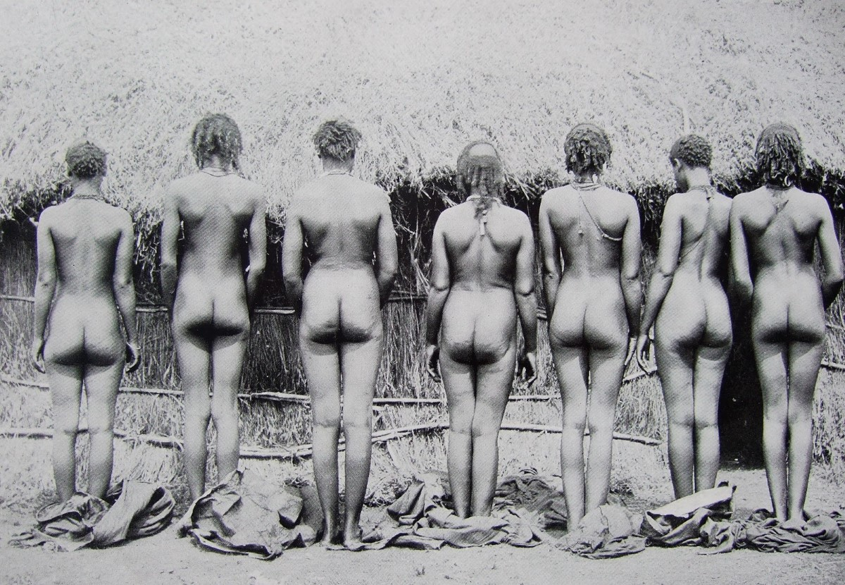

Slide 5
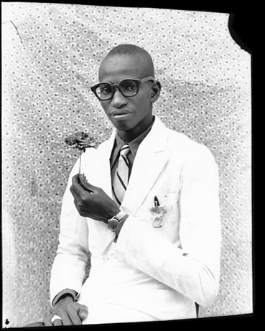
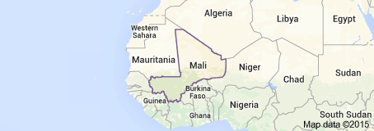
Seydou Keïta (Bamako, Mali, 1921-2001) most famous for studio portraits taken from the 1940s to the 1960s prior to independence from France.
Mali Independence Day: September 22, 1960
Self portrait

Slide 6
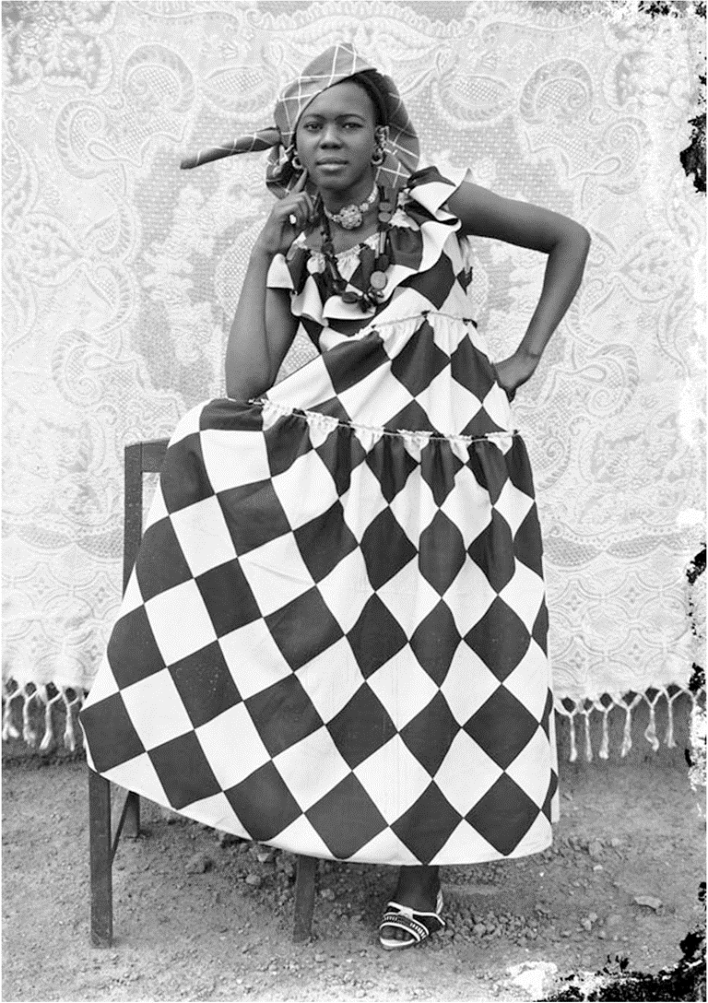
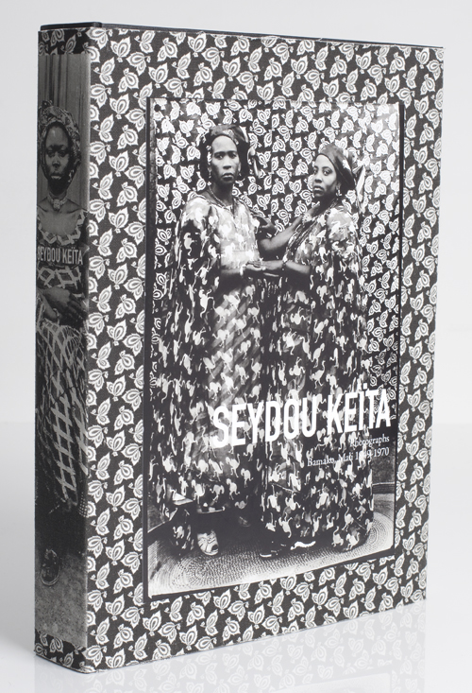

Slide 7
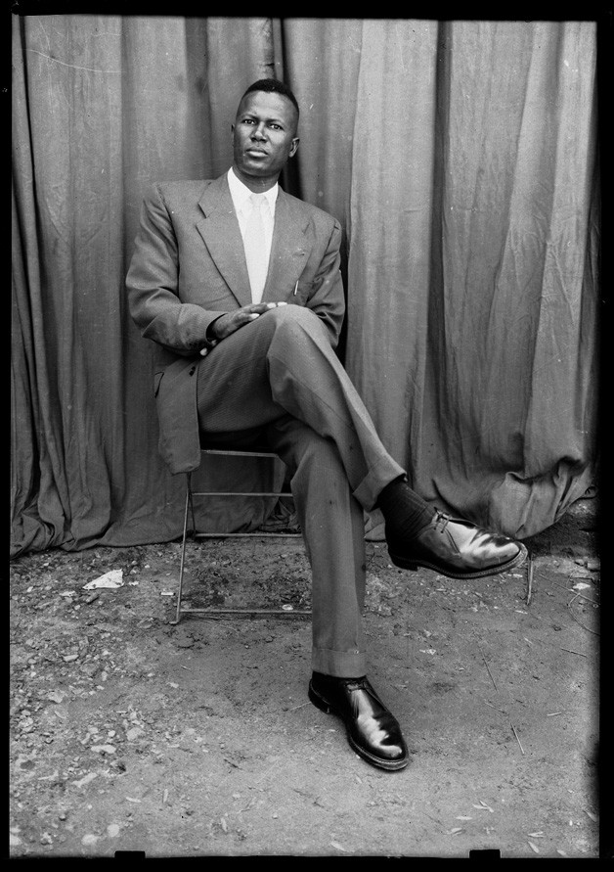
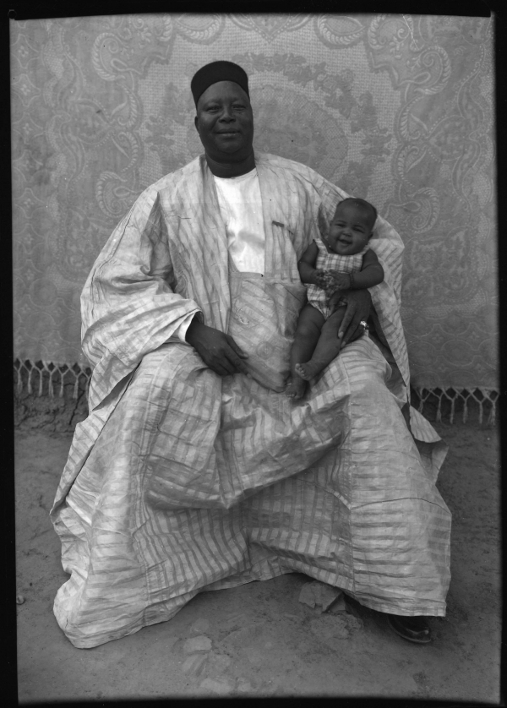
Seydou Keita, (left) Untitled, c. 1959; (right) Untitled, c. 1941; gelatin silver print,

Slide 8
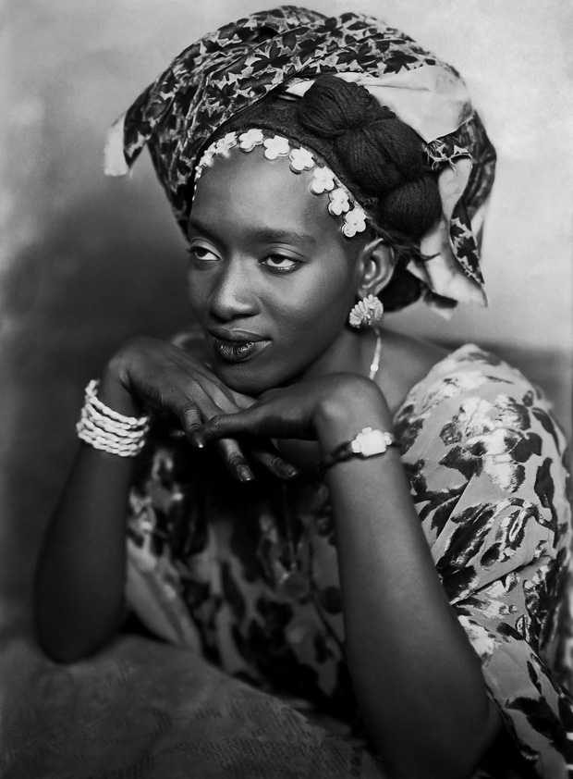
Mama Casset (b. Senegal, active in Mali, 1908-1992), Untitled, 1952

Slide 9
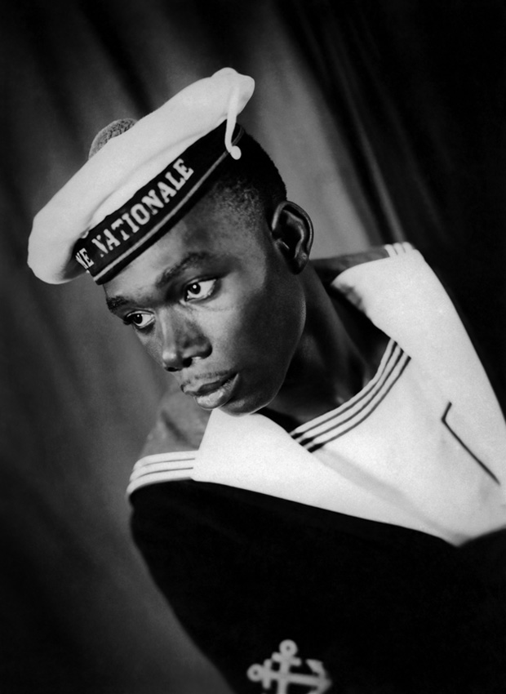
Mama Casset, Untitled, 1950

Slide 10
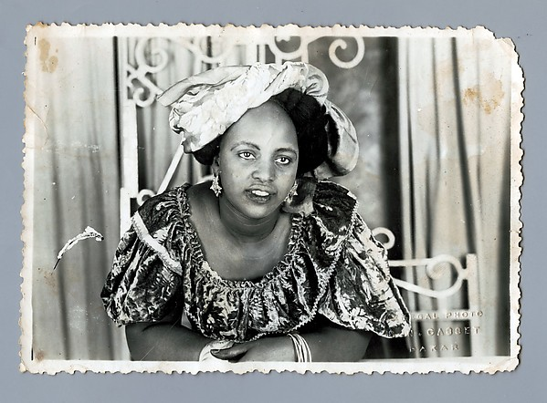
Salla Casset (Senegal, 1910-1974, brother of Mama Casset), Woman with Curtains, 1950s-1960s, gelatin silver print, Metropolitan MA, NYC

Slide 11
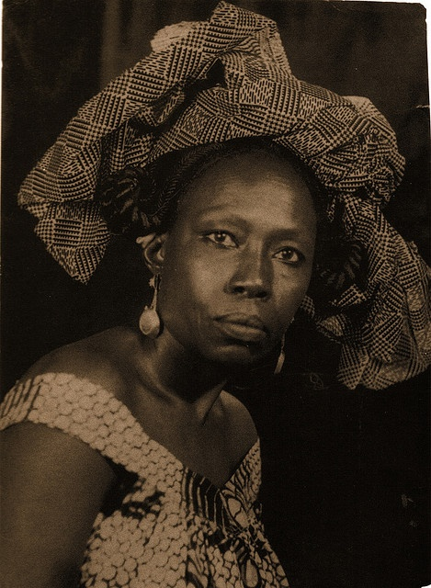
Meissa Gaye (Senegal, 1892-1982), Untitled, N/D (1950?)

Slide 12
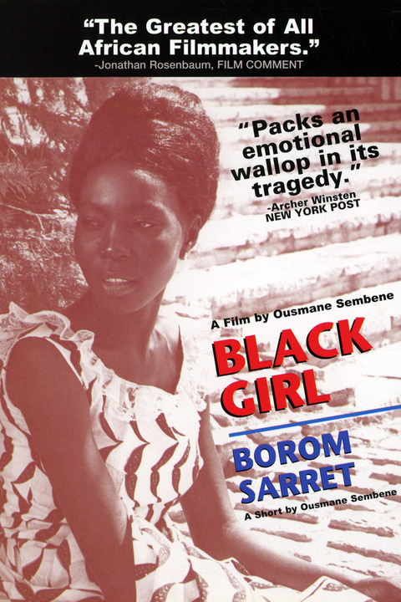
Ousmane Sembène (Senegal, 1923-2007), Black Girl (La Noire de…), film, 1966. The first film by an indigenous African to gain international attention.
https://vimeo.com/100189681

Slide 14
Ousmane Sembène, Xala, 1977

